Slide 1
Customer Service (CS)
Curriculum: Introduction to S4HANA using Global Bike

Slide 2

4.3 (July 2025)
SAP S/4HANA 2023
Fiori 3.0
Global Bike
No Prerequisites needed

Slide 3
Tim Böttcher
Chris Bernhardt
Stefan Weidner
Beginner

Slide 4
You are able to
name some functionalities of the CS module.
define the central organizational structures of the CS module.
summarize the master data which is most important for the CS module.
explain standard processes of the Customer Service.

Slide 5
Functionality
Service Contract
Service Notification
Service Order
Goods Return and Repair

Slide 6
Agenda
CS Organizational Structure
CS Master Data
CS Processes

Slide 7
GBI Structure for Customer Service
Global Bike
Client
Global Bike Inc.
Global Bike Germany GmbH
Company Code
New
York
Dallas
San Diego
Miami
Heidelberg
Hamburg
Plant
Maintenance Plant
Responsible Maintenance
Planning Plant
Misc.
Storage Location

Slide 8
CS Organizational Structure
Client
  An independent environment in the System
Company Code
  Smallest org unit for which you can maintain a legal set of books
Storage Location
  An organizational unit allowing differentiation between the various stocks of material in a plant
Plant
  Operating area or branch within a company
    Manufacturing, distribution, purchasing or maintenance facility
  Place in which the technical objects of a company are installed

Slide 9
CS Organizational Structure (Sales)
Sales Organization
  An organizational unit responsible for the sale of certain products or services.
  The responsibility of a sales organization may include legal liability for products and customer claims
Distribution Channel
  The way in which products or services reach the customer
  Typical examples of distribution channels are wholesale, retail, or direct sales
Division
  A way of grouping materials, products, or services
Sales Area
  Combination of Sales Organization, Distribution Channel and Division
  Determines conditions (i.e. pricing) for sales activities

Slide 10
Sales Area (example)
ElectroPro
Company Code
Northern Area
Southern Area
Sales Organization
Internet
Wholesale
Wholesale
Distribution Channel
Mobile
Kitchenware
Home
Entertainment
Kitchenware
Division
Sales Area
Notes:
E.g. introduce a new distribution channel → How many Sales Areas

Slide 11
CS Organizational Structure (Sales & Purchasing)
Sales Office
  establishes contact between the firm and the regional market
Sales Group
  performs and is responsible for sales transactions
Shipping Point
  performs shipping processing and is the part of the company responsible for the type of shipping, the necessary shipping materials and the means of transport
Picking Location
  place where the goods will be picked for shipping
Purchasing Organization
  organizational unit responsible for procuring services and materials

Slide 12
CS Organizational Structure (Controlling)
Operating Concern
  represents a part of an organization for which the sales market is structured in a uniform manner
  a operating profit for the individual market segments can be calculated
  multiple controlling areas can be assigned to one operating concern
Controlling Area
  a self-contained, organizational unit for which the management of revenues and expenses can be performed
  may include one or more company codes; therefore, an enterprise can perform management accounting analyses and reports across several companies
  a way to identify and track where revenues and costs are incurred for evaluation purposes

Slide 13
Agenda
CS Organizational Structure
CS Master Data
CS Processes

Slide 14
CS Master Data
Work Center
Equipment
Bill of Material
Customer Master Data
Material Master Data
Vendor Master Data
Notes:
anpassen

Slide 15
Work Center
A location within a plant where value-added work (operations or activities) are performed
  Work Centers can represent
    People or Groups of People
    Machines or Groups of Machines
    Assembly Lines
Work center used to define capacities
  Labor
  Machine
  Output
  Emissions
Capacities used in
  Capacity requirements planning (CRP)
  Detailed scheduling
  Costing

Slide 16
Equipment / Functional Location - Definition
Equipment
  Individual and autonomous technical unit
  Physical object for which maintenance tasks are planned and performed
  Equipments can be placed in functional locations
Functional Location
  Hierarchal organized structure which represents e.g. a technical system, a building or a part of it
  Structural depiction of a technical plant
  Planning and performing maintenance tasks
Classification
  assignment of an item or initiative to one or several buckets of a classification hierarchy
  The act of assigning a value of a given characteristic to an object

Slide 17
Equipment / Functional Location - Definition
Measuring point and counter reading
  describes the state of a technical object
  important for regulations, e.g. emission limits of a plant
Serial number
  used for individualization of materials
  distinguish materials with the same material number
  specify the exact location of an unique good
  save additional information
  e.g. manual, warranty information

Slide 18
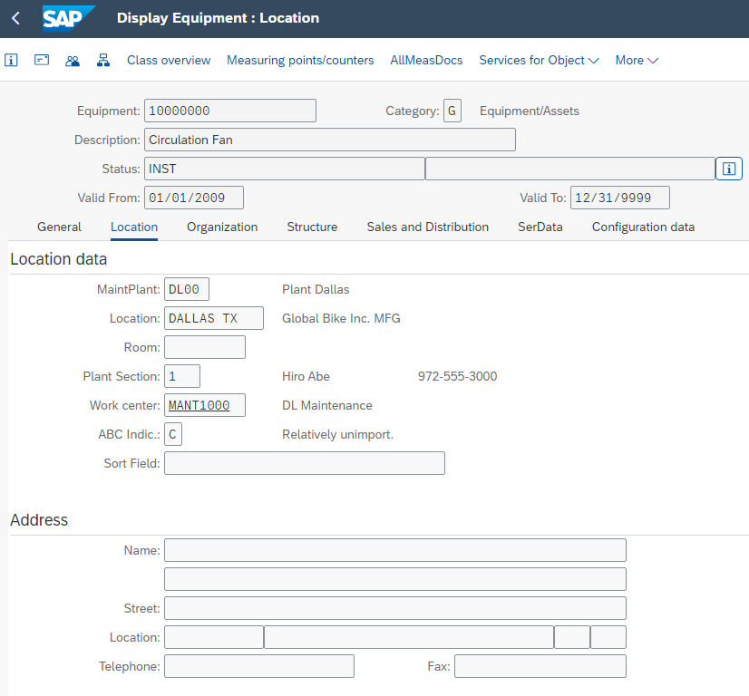
Equipment Master Record
Equipment Master Data
  contains all information around
  equipment
Information in four views:
  General
  Location
  Organization
  Structure

Slide 19
Warranties
A guarantee to vouch for defects or faults in the product purchased, valid for a specific period of time
The type and scope of the services covered, such as repairing a defect for free or taking the product back, are defined in the warranty
Can be distinguished in vendor-, manufacturer- or customer warranty
Valid for a specific technical object
  functional location, equipment or serial number

Slide 20
Bill of Material – Definition
Complete formally structured list of all components
Material BOMs can be allocated to functional locations or equipment
Three types of BOMs in Enterprise Asset Management:
  Material BOMs
  Equipment BOMs
  Functional location BOMs
Advantages
  Structuring of objects
  Service parts planning in maintenance orders and maintenance task lists
  Within plant maintenance BOMs are used, if similar object should be maintained

Slide 21
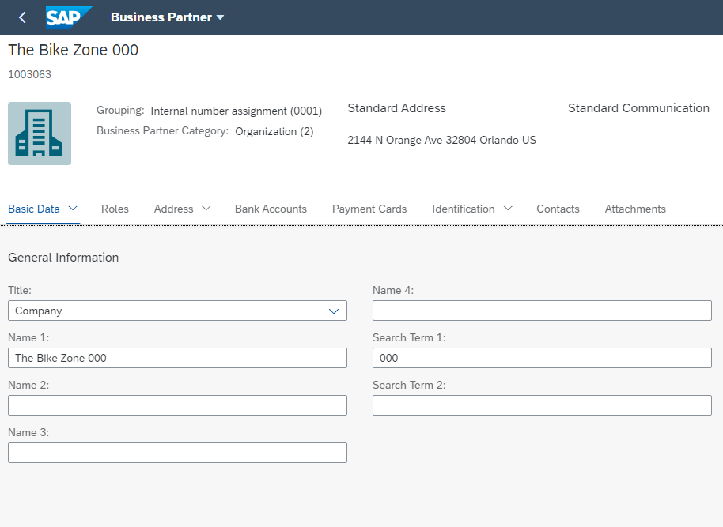
Customer Master Data
Customer Master
  Contains all of the information necessary for
  processing orders, deliveries, invoices and
  customer payment
  Every customer MUST have a master record
Created by Sales Area
  Sales Organization
  Distribution Channel
  Division
The customer master information is divided
into 3 areas:
  General Data
  Company Code Data
  Sales Area Data

Slide 22
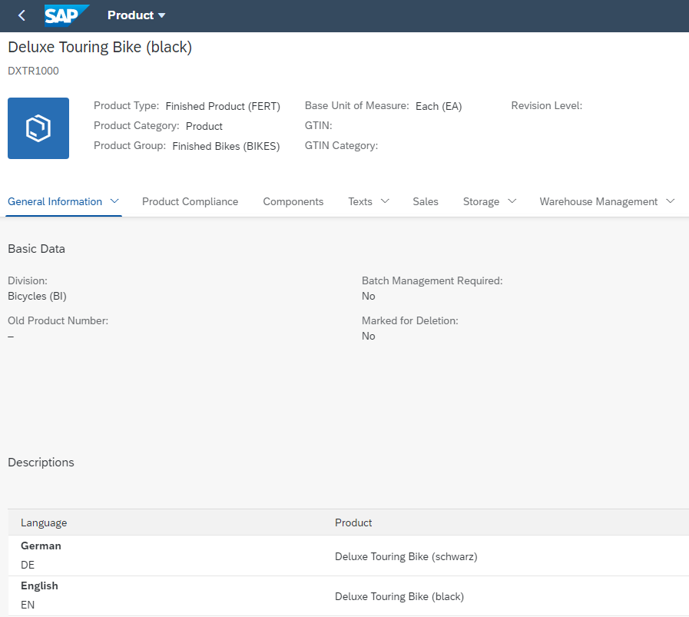
Material Master Data
Material Master
  Contains all the information a company needs to manage
  about a material
  It is used by most components within the SAP system
    Sales and Distribution
    Materials Management
    Production
    Plant Maintenance
    Accounting/Controlling
    Quality Management
  Material master data is stored in functional segments
  called Views

Slide 23
Material Master Views
Sales Data
Basic Data
Purchasing Data
Material Master
Mat. Plan. Data
Forecasting Data
Storage Data
Controlling Data
Quality Data
Accounting Data

Slide 24
Material Master
General Information relevant for the entire organization:
Name
Weight
Unit of Measure
Client XXX
Sales specific information:
Delivering Plant
Loading Grp
Storage Location specific information:
Stock Qty
Sales Org. UW00
Storage Loc. FG00
Sales Org. UE00
Storage Loc. TG00
Notes:
All of this together makes up the Master Record for a Material.

Slide 25
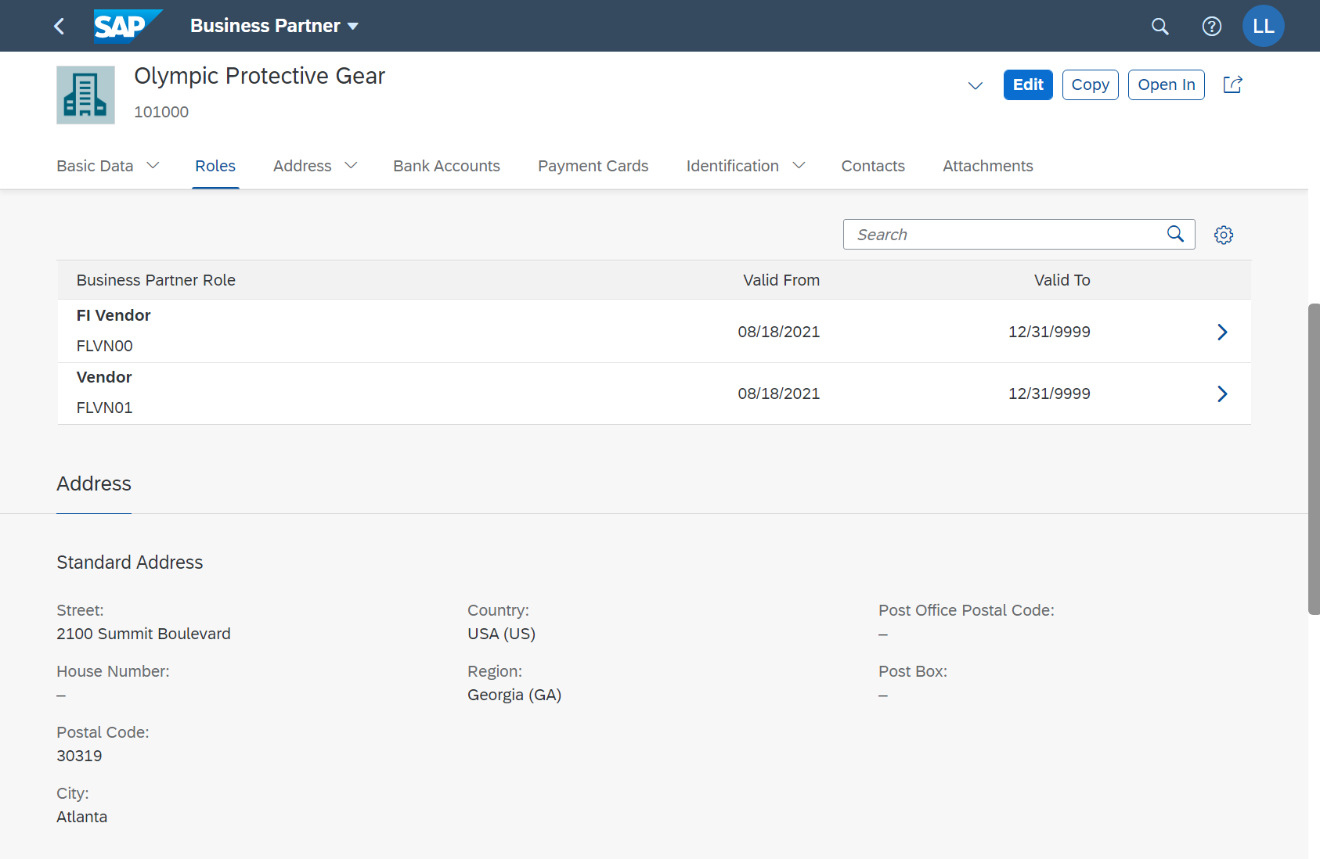
Vendor Master Data
Contains all the necessary information needed
to business with an external supplier
Used and maintained primarily by the
Purchasing and Accounting Departments
Every vendor MUST have a master record
The supplier master record is created in
SAP S/4HANA as a central business partner
master record with different roles.
For suppliers, these are often the business
partner roles:
  FLVN00 (FI Vendor)
  FLVN01 (Vendor)

Slide 26
Vendor Master Views
Client Level
  Address
  Vendor Number
  Preferred Communication
Company Code Data
  Reconciliation Account
  Terms of Payment
  Bank Account
Purchase Org Data
  Purchasing Currency
  Salesman’s Name
  Vendor Partners
General Data
Company Code Data
Financial Accounting (FI)
Purchasing Data
Materials Mgmt (MM)

Slide 27
Agenda
CS Organizational Structure
CS Master Data
CS Processes

Slide 28
Service Contract and Types
Long term agreement
  predefined validity period
  for at least one technical object
  predefined services
  predefined conditions
Header
  Sales-, contract-, and billing data
  Billing plan
  Conditions
Items
  Service
  Configuration
  Technical Objects
Service contract
  Solve reported problems of a customer
Service and maintenance contract
  Maintenance of technical object in a predefined manner
  Master agreement with a customer
  Reversal of a predefined quantity or value

Slide 29
Service Order - Process
Service Order
Planning and release
Business completion
Execution of activities
Confirmation and technical completion
Billing

Slide 30
Service Notification
Means by which notifications from a customer are entered and managed in Customer Service
Used for documentation and evaluation
Components
  Customer information
  Information about technical object and service contract
  Information about valid warranties
Types
  Customer message / problem notification
  Service request
  Technical completion
If there is need for action a service order will be created

Slide 31
Service Order
Precise assessment of time and ressources
Can be created as follow-up of a service notification
Planning of service actions
  Resource planning for internal and external employees
  Determination of specific execution date
Confirmation

Slide 32
Service Order - Content
Customer information
Information about the location
Object information
Information about planning and execution of activities
Information about planned and actual costs
Information about settlement of the actual costs

Slide 33
Goods return and repair - Process
Customer message
Good issue
Billing
Goods receipt
Customer repair order
Service order
Technical inspection
Repair

Slide 34
Goods return and repair
Return of a damaged good
Receipt through goods return
Repaired through customer service
Billing

